Slide 1
UT Southwestern - VitalSign⁶ with Healthcare Services of North Texas
RHP 9/RHP 10 Learning Collaborative
May 28, 2015

Slide 2
Agenda
VitalSign⁶ Overview
Why now and why in Primary Care?
Depression as a Co-Morbid Chronic Disease
The Vital Sign6 iPad Application
Using Measurement Based Care in the Primary Care Setting
VitalSign6 Outcomes Data
Clinic Impact
Healthcare Services of North Texas, Kayla Gulling, LCSW
Next Steps

Slide 3
UT Southwestern Overview
2 Hospitals: William P. Clements Jr. University Hospital and Zale Lipshy University Hospital
74 ambulatory clinics
Clinical Affiliation Program (UTSCAP): 150 community-based, independent physicians enrolled.
Teaching Hospitals affiliated with UTSW:
Parkland Memorial Hospital
Children’s Medical Center
UT Southwestern Medical Center has three degree-granting institutions
20 DSRIP Projects: 3 Hospital, 2 Workforce, 8 UTSCAP, and 7 Ambulatory Projects

Slide 4
UT Southwestern Medical Center: Areas of Focus in the Waiver
Expand access to services for those who otherwise would not have access.
Innovate new service delivery options
Strengthen Primary Care networks and target workforce development for medical professional shortages
Develop population health management and care coordination across the continuum of care
Breakdown silos of service delivery
Align healthcare initiatives
Begin implementing a pay for performance infrastructure
Establish the principles of the Triple Aim

Slide 5
Overview of VitalSign⁶: Making Screening for Depression the Sixth Vital Sign
A Comprehensive program to identify and treat depression in the Primary Care Setting.
It is a web based application using the Patient Health Questionnaire and other validated scales.
The iPad application allows for self rating during the triage process.
Screening is just the first step- should be universal
VS6 is a Measurement Based Care (MBC) approach with the goal of full remission- should be routine

Slide 6
VitalSign⁶ Screening Data – TOTAL (Total, Positive, Negative) August 21, 2014 – May 20, 2015
Total Number of Patients
Screened
*Total patients with positive PHQ-9 is 1500.
And They Said It Cannot Be Done

Slide 7
Prevalence of psychiatric disorders in low-income primary care patients
Psychiatric disorder | General Primary care population | Low-income patients
At least one psychiatric disorder | 28% | 51%
Depression and Related Mood disorder | 16% | 33%
Anxiety disorder | 11% | 36%
Alcohol abuse | 7% | 17%
Eating disorder | 7% | 10%
*35% of patients with a psychiatric diagnosis saw their PCP in the past 3 months.
Mauksch, L. B., et al. (2001). Mental illness, functional impairment, and patient preferences for collaborative care in an uninsured, primary care population. Journal of Family Practice, 50(1), 41-47.

Slide 8
Major Depressive Disorder (MDD) Is Still Largely Untreated
Patients with MDD in the last 12 months
51.6% of patients with MDD received some treatment
58.1% of treated patients received inadequate treatment
41.9% of treated patients received at least minimally adequate treatment
48.4% of patient with MDD did not receive any treatment
* Only 21.6% of all patients with MDD in this study received adequate treatment
Kessler RC, et al. JAMA. 2003;289(23):3095-3105.

Slide 9
Why VitalSign⁶
And Yet..
The STAR*D study showed it is possible to provide high quality treatment in primary care setting with outcomes equal to those provided by specialty care ^{1,2,3}.
Therefore, the MBC approach is highly recommended for primary care settings.
¹Trivedi, et al Am J Psychiatry 2006; ²Trivedi et al New England Journal of Medicine 2006;
³Gaynes et al 2009
Notes:
For those treated with anti depressants – make this the niche of what our program. We take protocol and mirror the protocol how you would manage other chronic diseases. If your BP wasn’t improving, you would increase the dose. We have mirrored this approach with evidence based research (MBC).
What STAR-D showed us is that treatment of MDD can be successful in primary care settings as long they are taught and implement MBC for treatment of MDD.

Slide 10
STAR
Sequenced Treatment Alternatives
D
to Relieve Depression
http://www.star-d.org

Slide 11
STAR*D: Treatment Algorithm
INITIAL TREATMENT: citalopram
Level 1
Level 2
SWITCH TO: bupropion-SR or cognitive therapy or sertraline or venlafaxine-ER
OR AUGMENT WITH: bupropion-SR or buspirone or cognitive therapy
(Only for those receiving cognitive therapy in Level 2)
SWITCH TO: bupropion-SR or venlafaxine-ER
Level 2a
SWITCH TO: mirtazapine or nortriptyline
OR AUGMENT WITH: lithium or triiodothyronine (only with bupropion-SR, sertraline, venlafaxine-ER)
SWITCH TO: mirtazapine or nortriptyline
OR AUGMENT WITH: lithium or triiodothyronine (only with bupropion [sustained-release], sertraline, venlafaxine [ER])
Level 3
SWITCH TO: tranylcypromine or mirtazapine combined with venlafaxine-ER
Level 4
STAR*D=Sequenced Treatment Alternatives to Relieve Depression.
Rush AJ et al. Am J Psychiatry. 2003;160:237.

Slide 12
Measurement-Based Care in STAR*D Citalopram Treatment of Depression
100
Dose: 41.8 mg (S.D. 16.8)
Duration: 10.0 weeks (S.D. 4.2)
47%
50
Percent
33%
0
QIDS-SR
Response
Rate
QIDS-SR
Remission
Rate
QIDS-SR ↓ ≥ 50%
QIDS-SR ≤ 5
Trivedi MH, et al. Am J Psychiatry. 2006;163:28-40.

Slide 13
Similar Outcomes in Primary and Psychiatric Care Settings
100
90
Primary Care
80
Psychiatric Care
70
%
60
46
48
50
40
26.6
28
30
20
10
0
Response
Remission
N = 2,876

Slide 14
STAR*D Clinical Study Results Remission Rates: Combination vs Monotherapy
Level 1
Level 2
(1 Failure)
Level 3
(2 Failures)
Level 4
(3 Failures)
40
11.9 weeks
8-10 weeks
<14 weeks
<14 weeks
Mono
Combo
30
% Remission
Mono
20
Combo
Combo
Mono
Mono
10
Low
Treatment Resistance
High
Mono = monotherapy
Combo = combination treatment
McGrath et al. 2006
Rush et al. 2006 Nierenberg et al. 2006
Trivedi et al. 2006a
Trivedi et al. 2006b
3429.02

Slide 15
Remissionª Rates (L-1) By Number of GMCs^{b}
(1354)
(612)
(420)
(224)
(257)
x² = 16.6 p=.0023
ª By QIDS-SR₁₆ < 5.
^{b} By the Cumulative Illness Rating Scale (CIRS).

Slide 16
STAR*D Clinical Study Results Relapse Rates (QIDS-SR₁₆ ≥11)
Level 2
(1 Failure)
Level 3
(2 Failures)
Level 4
(3 Failures)
Level 1
90
70
% Relapse
50
30
Low
Treatment Resistance
High
= In remission
= Not in remission
Rush et al. 2006
New #
Notes:
Relapse rates during follow-up increased with more treatment steps:
1: 40.1% 2: 55.3% 3: 64.6% 4: 71.7%
Lower rates of relapse found for patients who were in remission when they entered follow-up than for patients who were not (same pattern in both groups)
In remission: 33.5 47.4 42.9 50.0
Not: 58.6 67.7 76.0 83.3

Slide 17
Relapseª Rates (L-1 Follow-up) by Number of GMCs^{b}
(385)
(161)
(123)
(67)
(70)
ª By QIDS-SR₁₆ > 11
^{b} By the Cumulative Illness Rating Scale (CIRS).

Slide 18
Why is it important to screen for depression?
GMCs have
high rates of depression and anxiety
impairs self-care and compliance with treatment of their chronic disease
Major cause of ER visits, readmissions
Poverty and poor health are associated with higher rates of mental disorders.
Hispanics and other ethnic minorities
disproportionate burden of disability
lower follow up rates, lower remission rates
For most people their primary care physician is their only contact with the health care system
Co-occurring mental and medical illness are common.

Slide 19
Depression and Diabetes
Depression is frequently co-morbid with diabetes
A meta-analysis found diabetes doubled the odds of co-morbid depression
This co-morbidity had greater prevalence in women (28% of women compared to 18% of men)
Patients with this co-morbidity have higher rates of mortality and more diabetes-related complications
Anderson et al., 2001 Diabetes Care; Pan et al., 2011 Arch Gen Psych; de Groot et al., 2001, Psychosom Med

Slide 20
Glitazones and Depression
Interestingly, glitazones have shown efficacy in managing depression symptoms
Pioglitazone was shown to improve depression (as measured by the HDRS) in non-diabetic but obese patients
However, not through mechanisms related to its insulin-sensitizing action or other biochemical changes (fasting insulin, glucose, lipid profile, liver enzymes)
Adjunctive treatment of pioglitazone to citalopram reduced scores on the HAMD and increased frequency of early improvement, time to response, and remission
Use of rosiglitazone in non-diabetic depressed patients indicated improvement in depression symptoms (HDRS and CGI) but without improvements in endocrine markers (TG/HDL ratio, BMI)
Kashani et al., 2013 Psychoneuroendorincol; Sepanjnia et al., 2012 Neuropsychopharmacol; Rasgon et al., 2010 Scien World J

Slide 21
Complex Relationship Between Chronic Medical Illness and Depression
Increased depression and anxiety
Poor adherence
Increased perception of symptoms
Additional impairment in functioning
Chronic medical illness
Increased risk of complications, higher medical costs
Notes:
Adults with common medical disorders have high rates of depression and anxiety, which often impair self-care and compliance with treatment of their chronic disease.
Major depression increases the burden of chronic illness by increasing perception of symptoms, causing additional impairment in functioning, and increasing medical cost through overutilization of the healthcare system.
People who have suffered a stroke or who have heart disease, diabetes, cancer, Parkinson’s disease, and/or HIV/AIDS are at a much greater risk for depression than the overall population.
Annual prevalence estimates of depression for these groups range from 10% to 65%.

Slide 22
Spectrum of Symptoms in Depression
Mood and Anxiety
Symptoms
Sadness and tearfulness
Loss of interest
Anxiety / Irritability
Hopelessness
Concentration difficulties
Guilt
Suicidal ideation
Physical Symptoms
Tiredness / fatigue
Sleep disturbances
Headaches
Psychomotor activity changes
GI disturbances
Appetite changes
Body aches and pains
Patients with depression can present with emotional and/or physical symptoms
APA. DSM-V;
Notes:
The symptoms are listed per the DSM-IV
Patients with depression can present with emotional and/or physical symptoms

Slide 23
Depression as a Chronic Disease
Depression in conjunction with any other chronic disease complicates the clinical picture.

Slide 24
Measurement-Based Care (MBC)
Routine Assessment of Symptoms and Side Effects
Timely Adjustments of Dose or Type of Treatment
Algorithm with Critical Decision Points
Timely Revisions in Sequence Depending on Outcomes
Trivedi MH, et al. Am J Psychiatry. 2006;163:28-40.

Slide 25
Patient Health Questionnaire-9 (PHQ-9) Symptom Checklist
Over the last 2 weeks, how often have you been bothered by the following problems?
More than
Half the Days
Nearly Every
Day
Not at All
Several
Days
a. Little interest or pleasure in doing things
b. Feeling down, depressed, or hopeless
c. Trouble falling or staying asleep, or sleeping too much
d. Feeling tired or having little energy
e. Poor appetite or overeating
f. Feeling bad about yourself, or that you are a failure . . .
g. Trouble concentrating on things, such as reading . . .
h. Moving or speaking so slowly . . .
i. Thoughts that you would be better off dead . . .
Subtotals:
3
4
9
Total: 16
Kroenke K, et al. J Gen Intern Med. 2001;16(9):606-613.
Notes:
PHQ-9 Symptom Checklist
Key Points
This slide illustrates the Patient Health Questionnaire (PHQ)-9 Symptom Checklist. The checklist was developed to make criteria-based diagnoses of depression in the primary care setting and is effective in monitoring therapeutic response.
A diagnosis of major depression is made if at least 5 of the depressive symptom criteria have been present for “more than half the days” during the last 2 weeks. The PHQ-9 score can range from 0 to 27; “not at all” is scored 0, with increasing scores from “several days” to “nearly every day.”
Reference
Kroenke K, Spitzer RL, Williams JB. The PHQ-9: validity of a brief depression severity measure. J Gen Intern Med. 2001;16:606-613.

Slide 26
FIBSER—Burden Item
FIBSER 5–6 = Unacceptable
FIBSER 3–4 = Attention Required
FIBSER 0–2 = Acceptable
Abbreviation: FIBSER = Frequency, Intensity, and Burden of Side Effects Ratings
https://outcometracker.org/library/FIBSER.pdf.

Slide 27
Patient Adherence Questionnaire-9

Slide 28
Aligning Healthcare Initiatives
Meaningful Use, ACO Measures, and HRSA Requirements
Screening for clinical depression
MDD diagnostic evaluation
Documentation of a Follow-Up Plan
Rates of Remission
Notes:
It will follow the same path as Diabetes and those clinics participating in VS6 are paying the way for establishing screening for MDD in Primary Care.
Combine 15 and 16

Slide 29
Meaningful Use and Measurement-Based Care
Routine use of Measurement-Based Care will allow providers to potentially satisfy 6 of the following clinical quality measures:
Screening for clinical depression
Utilization of the Patient Health Questionnaire-9 (PHQ-9) screening tool
Diagnostic evaluation for major depressive disorder
Management of antidepressant medication
Depression remission at 6 months
Depression remission at 12 months

Slide 30
APA Guideline Recommendations for Treating Adults With Major Depressive Disorder
Two new treatment guidelines for major depressive disorder (MDD) emerged in 2010:
An updated practice guideline from the American Psychiatric Association¹
A universal treatment algorithm for MDD from an international panel of psychiatric experts²
These guidelines recommend^{1,2}:
Switching or augmentation after an inadequate response to an optimized initial antidepressant trial
Using an atypical antipsychotic as an augmentation option
Repetitive transcranial magnetic stimulation and exercise
Using measurement-based care to detect unresolved symptoms
American Psychiatric Association. Practice guideline for the treatment of patients with major depressive disorder. 3rd ed. Arlington, VA: American Psychiatric Association; 2010. http://psychiatryonline.org/data/Books/prac/PG_Depression3rdEd.pdf. Accessed August 6, 2014.
Nutt DJ, Davidson JR, Gelenberg AJ, et al. J Clin Psychiatry. 2010;71(suppl E1):e08. doi: 10.4088/JCP.9058se1c.08gry.
Notes:
30
Recent clinical practice guidelines for major depressive disorder (MDD) have been developed based on current evidence and clinical consensus. These 2010 guidelines include:
A depression treatment algorithm created by experts in psychiatry who gathered for a meeting of the International Consensus Group on MDD.
This algorithm was adapted from Japan’s existing treatment guidelines for depression.
Country-specific issues were then discussed (including screening for and diagnosing depression, treatment in primary vs. specialty care, preferred treatments, cost, and optimal dosing).
The American Psychiatric Association updated their clinical practice guidelines for the treatment of patients with MDD based on current evidence and clinical consensus.
Both of these new guidelines have common recommendations that include:
Choosing an initial antidepressant therapy, optimizing the dose, and reassessing symptomatic improvement
Using measurement-based tools to screen symptoms and monitor treatment response
After an inadequate response to initial therapy, options include optimizing the dose of a current medication or switching or augmenting medication
Augmentation options for an inadequate response include an atypical antipsychotic.
References
Nutt DJ, Davidson JRT, Gelenberg AJ et al. International consensus statement on major depressive disorder. J Clin Psychiatry. 2010;71[suppl E1]:e08.
American Psychiatric Association. Practice Guideline for the Treatment of Patients With Major Depressive Disorder. Arlington, VA: American Psychiatric Association; 2010.
Nutt 1A, 2B, 6C
Nutt 1A, 2B, 6C

Slide 31
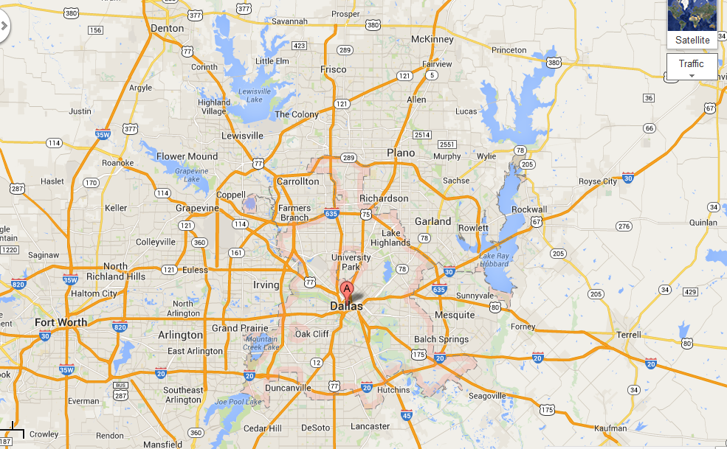
Active Waiver Clinics
UTSW
Clinic
Charity clinics
Agape
Brother Bill’s Helping Hand
North Dallas Shared Ministries
Healing Hands Ministry
FQHCs
HSNT (4 clinics)
UTSCAP/Private Clinics
Compassion Care Clinic
Dr. Amanda Perez
Healthcare Clinics

Slide 32
The VS6 Application

Slide 33
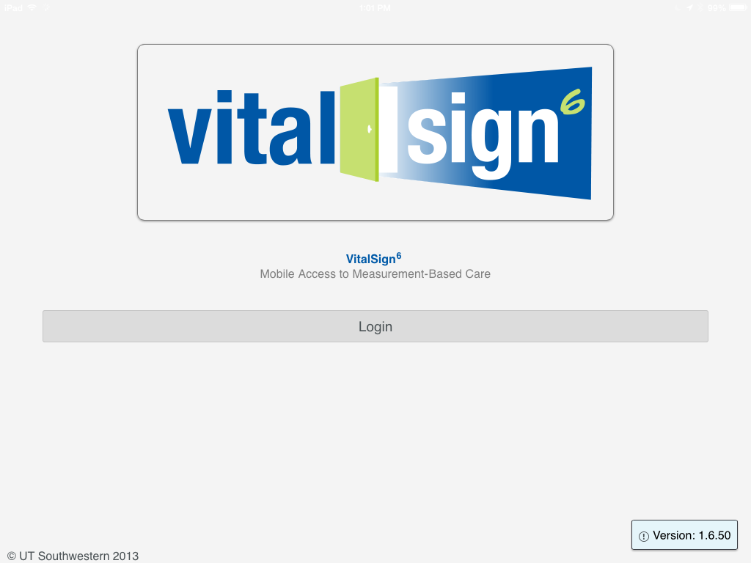
Patient Rated Tool
Tap the Login Bar

Slide 34
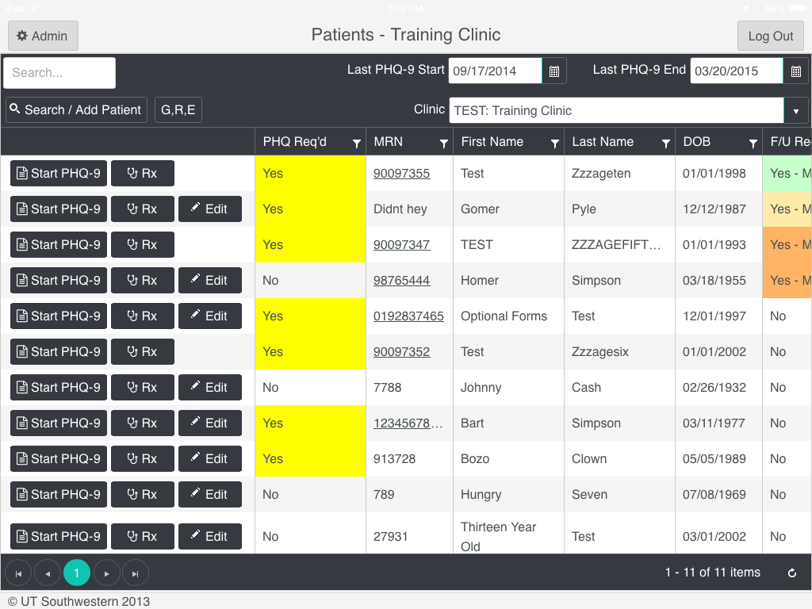
The Patient List screen opens

Slide 35
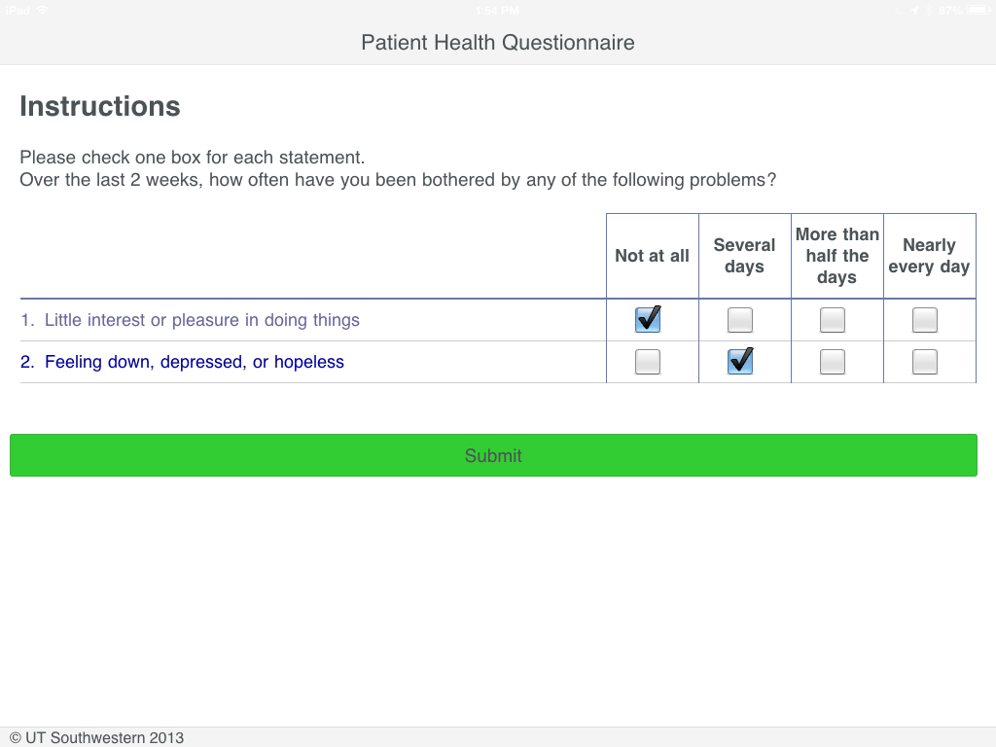
In this case the PHQ-2 screen is negative (<3)
No more questions are required
The "Submit" bar is presented
The patient taps "Submit" and the screen is complete

Slide 36
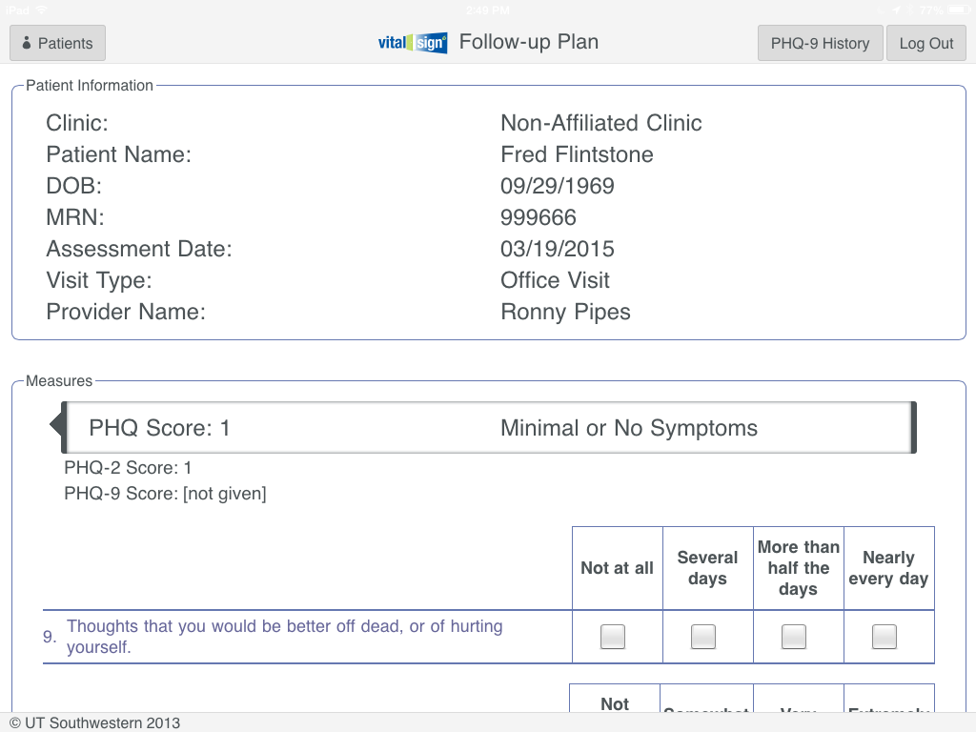
3
The application opens to the scores and meanings for the questionnaires the patient just completed.

Slide 37
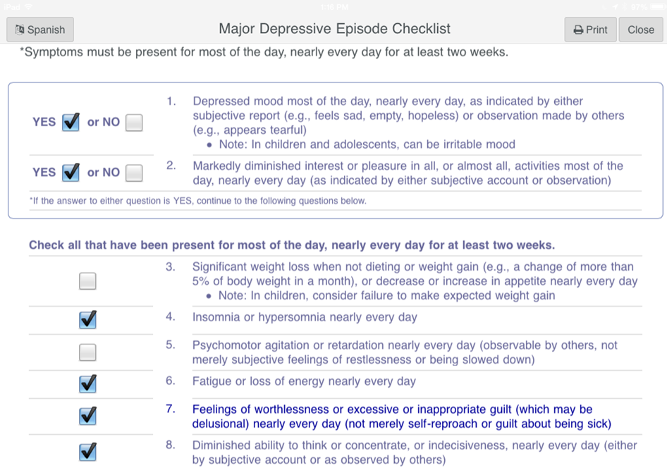
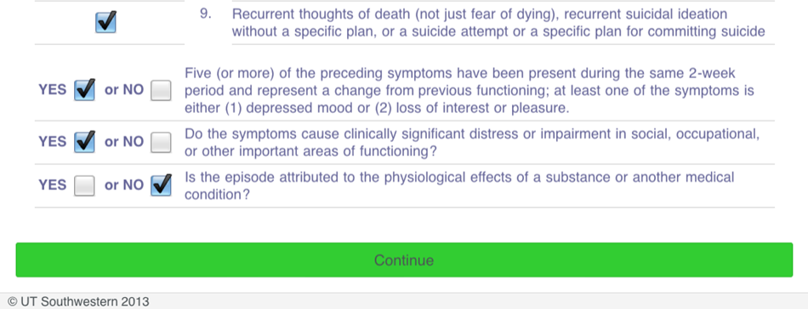
Major Depressive Episode Checklist
It’s also available in Spanish

Slide 38
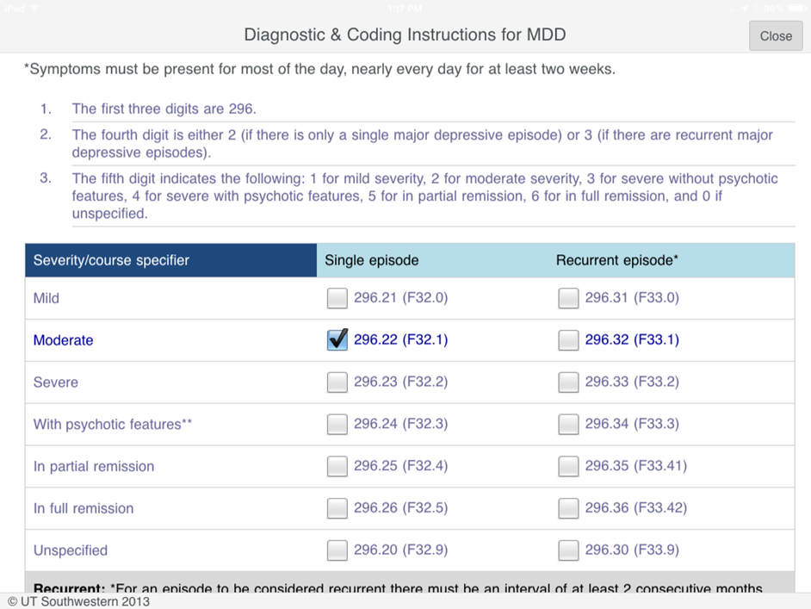
Diagnostic and Coding Instructions for MDD

Slide 39
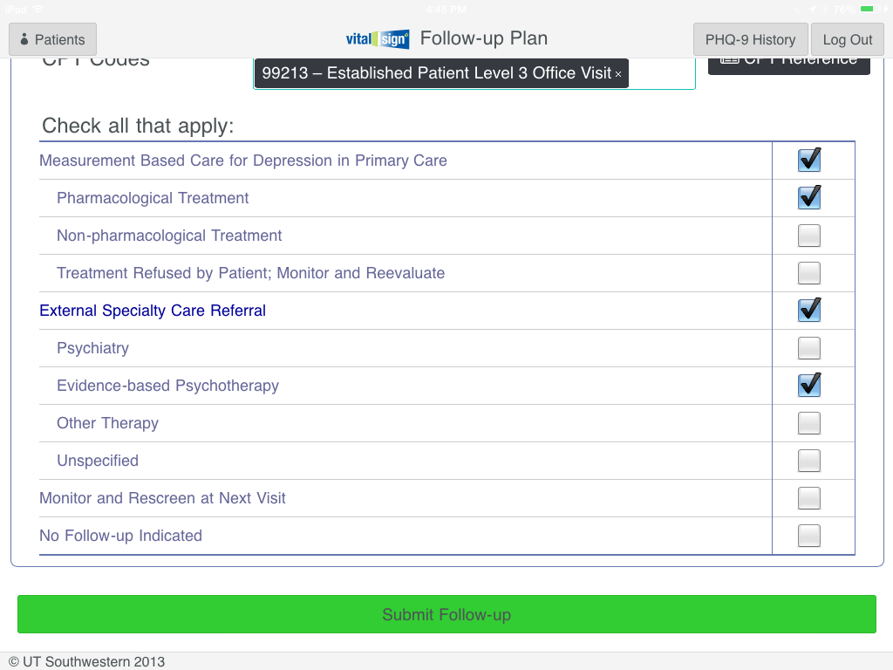
Once you have checked all of the appropriate treatment options, tap “Submit Follow-up.“

Slide 40
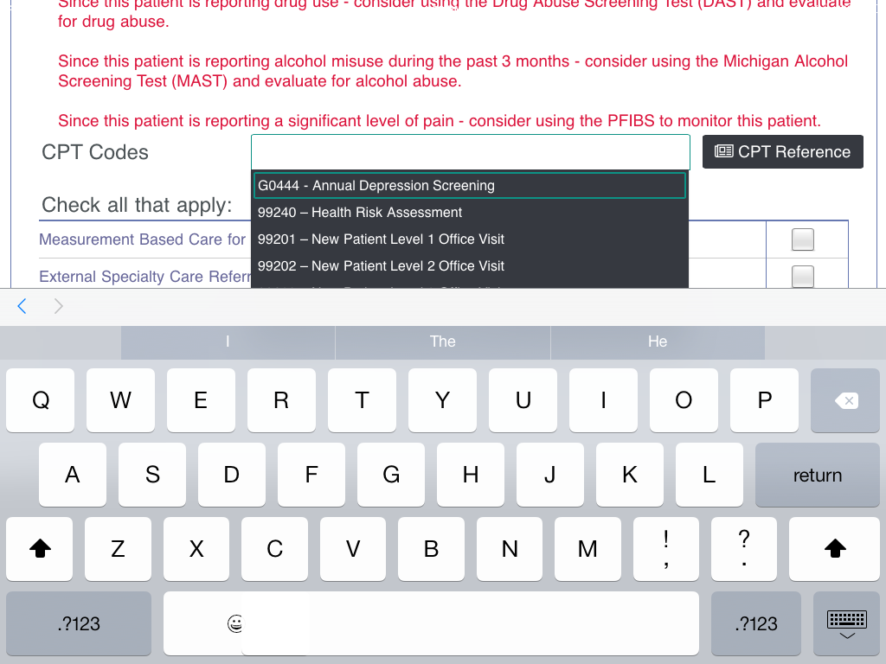
Tap the “CPT Code Reference” button to see these pages. . .
Notes:
Slides 78 through 84 for physicians only.

Slide 41
Notes:
Slides 78 through 84 for physicians only.

Slide 42
VitalSign⁶ Outcomes Data

Slide 43
VitalSign⁶ Screening Data – TOTAL (Total, Positive, Negative) August 21, 2014 – May 20, 2015
Total Number of Patients
Screened
*Total patients with positive PHQ-9 is 1500.
And They Said It Cannot Be Done

Slide 44
Screening Data by Months (Total, Positive, Negative, MDD Confirmed) August 21, 2014 – May 20, 2015

Slide 45
VS⁶ Depression Screening Process
PRELIMINARY REPORT

Slide 46
PHQ 9 Score Changes for Patients in Measurement Based Treatment August 21, 2014 – May 20, 2015
Total Patients: 329
Those who scored positive on PHQ-9; confirmed Dx of MDD , are in MBC and have a follow up visit

Slide 47
Measurement Based Care for those the VitalsSign⁶ Clinics
*N=898 patients diagnosed with MDD

Slide 48
Improvement and remission in patients using Measurement Based Care August 21, 2014 – May 20, 2015
*Remission = PHQ-9 less than 5
*Total Patients: 108

Slide 49
Clinic Impact
Healthcare Services of North Texas
(HSNT)

Slide 50
HSNT Stats as of May 2015
Started screening November 2014
2097 patients screened
23% of patients screened positive on PHQ-9
77% of patients screened negative on PHQ-9

Slide 51
Healthcare Clinics of North Texas Total Number of Patients Screened

Slide 52
HSNT: PHQ 9 Score Changes for Patients in Measurement Based Treatment August 21, 2014 – May 20, 2015

Slide 53
HSNT: Improvement and Remission in patients using Measurement Based Care August 21, 2014 – May 20, 2015
*Remission = PHQ-9 less than 5
*Total Patients: 33

Slide 54
VitalSign⁶
Integrated Behavioral Health
Kayla Gulling, LCSW
Lead Behavioral Therapist HSNT

Slide 55
Healthcare Services of North Texas Who are we.
FQHC located in Denton, TX
Behavioral health provider co-located with medical provider
Co-ordination of care
Treating patient holistically
Availability for brief interventions and warm hand offs.
Care manager to follow patients
VitalSign⁶ program with UTSW – Annual Depression screening for all patients over the age of 13

Slide 56
Why VS6 works at HSNT
It directs patients to the in-house behavioral health team for treatment and care coordination.
The screening has identified patients with MDD who would otherwise go un-diagnosis; therefore, untreated.
We began using the PHQ for screening in July 2014, so moving to the iPad application was a logical progress for further integration.
For those with a positive screen, we screen at every encounter whether it is a PCP or Behavioral health visits.

Slide 57
What was “easy” and “not so easy” about implementing VS⁶
Easy
The expectation to screen was established by the organization prior to VS⁶.
Workflow integration was not as hard as we thought it would be. It was inserted at the time of triage.
By presenting the screen application during the triage process as the “6th Vital Sign” patients understand it is standard for everyone.
Not so easy
EHR and application integration. Currently, manual entry and extraction is needed to provide a comprehensive clinical picture of a person’s treatment.

Slide 58
Patient Story
A 27 year old uninsured female came to HSNT for a well woman exam. She was screened for depression using VS6 and scored a 14 the PHQ-9. With a positive screening result, the BH provider contacted patient to discuss diagnosis and treatment options for depression. The patient stated she has struggled with depression for a long time, but didn’t think anyone could help her. Since this intervention, the patient started on medication and had three therapy sessions. Medication adjustments were made by the primary care provider and the care team continues to monitor the patient closely. With proper medication management and supportive therapy, her depressive symptoms have reduces and she is on her way to remission.

Slide 59
Patient Stories Cont.
A 58 year old female attended a follow-up appointment with her primary care provider for obesity, HTN, and diabetes. Historically, she had several positive PHQ-9 screens but declined BH supports and medication therapy. However, during a recent visit, she agreed to BH services and scheduled a follow up with the BH provider. During the visit, the BH provider and patient discussed depressive symptoms and developed initial goals aimed at doing pleasurable activities and organizing medications to better care for her HTN, diabetes, and obesity. The patient continued to decline medication therapy, but clearly began to take ownership over improving her depressive symptoms. By the next visit, her PHQ-9 score decreased two points and more attainable goal-oriented activities were established. By the fourth session, her PHQ-9 score reflected remission. By using a Measurement Based Care approach, the patient and the provider were able to see the positive effects of her treatment, even without medication.

Slide 60
Key Next Steps Madhukar H. Trivedi, MD

